Slide 1
The Future of Mankind !
~By Kunal Chaudhari

Slide 2
Who is Nikolai Kardashev?
Nikolai Semenovich Kardashev. 25 April 1932 – 3 August 2019) was a Soviet and Russian astrophysicist, Doctor of Physical and Mathematical Sciences, and the deputy director of the Astro Space Center of PN Lebedev Physical Institute of the Russian Academy of Sciences in Moscow.

Slide 3
So What is Basically the Kardashev scale ?
The Kardashev scale is a method of measuring a civilization's level of technological advancement based on the amount of energy they are able to use. The measure was proposed by Soviet astronomer Nikolai Kardashev in 1964.[1] The scale has three designated categories:
A Type I civilization, also called a planetary civilization—can use and store all of the energy available on its planet.
A Type II civilization, also called a stellar civilization—can use and control energy at the scale of its planetary system.
A Type III civilization, also called a galactic civilization—can control energy at the scale of its entire host galaxy.

Slide 4
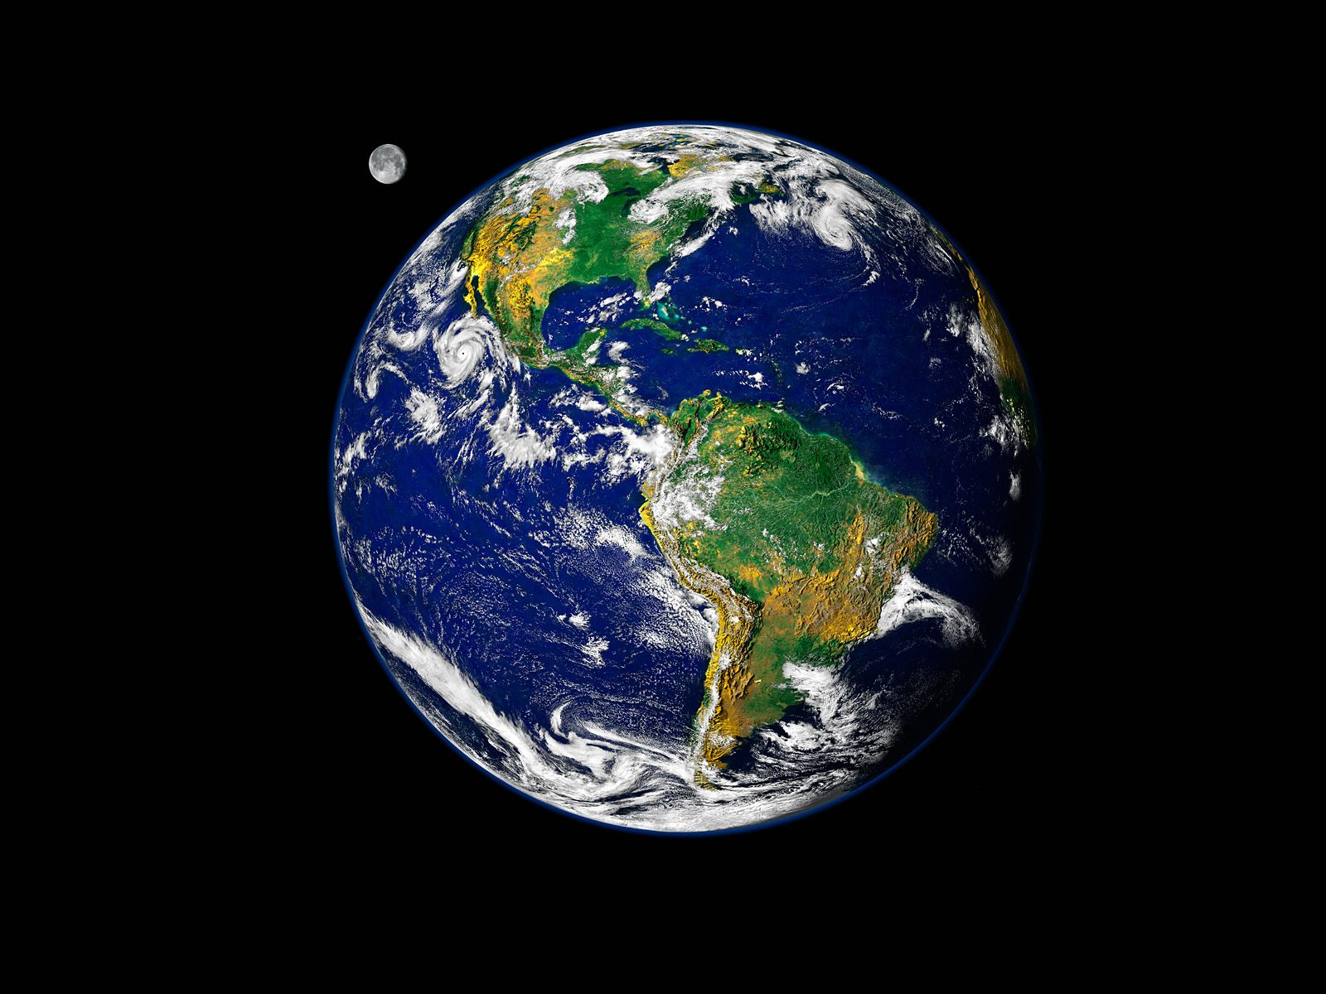
Current status of human civilization
At the current time, humanity has not yet reached Type 1 civilization status. Physicist and futurist Michio Kaku suggested that, if humans increase their energy consumption at an average rate of 3 percent each year, they may attain Type I status in 100–200 years, Type II status in a few thousand years, and Type III status in 100,000 to a million years.
Where value K is a civilization's Kardashev rating and P is the power it uses, in watts. Using this extrapolation, a "Type 0" civilization, not defined by Kardashev, would control about 1 MW of power, and humanity's civilization type as of 1973 was about 0.7 (apparently using 10 terawatts (TW) as the value for 1970s humanity).
In 2018, the total world energy consumption was 13864.9 Mtoe (161,249 TWh), equivalent to an average power consumption of 18.40 TW or 0.73 on Sagan's interpolated Kardashev scale.

Slide 5
The Kardashev Scale – Type I, II, III
We have reached a turning point in society. According to renowned theoretical physicist Michio Kaku, the next 100 years of science will determine whether we perish or thrive. Will we remain a Type 0 civilization, or will we advance and make our way into the stars?
Experts assert that, as a civilization grows larger and becomes more advanced, its energy demands will increase rapidly due to its population growth and the energy requirements of its various machines. With this in mind, the Kardashev scale was developed as a way of measuring a civilization’s technological advancement based upon how much usable energy it has at its disposal (this was originally just tied to energy available for communications, but has since been expanded).

Slide 6
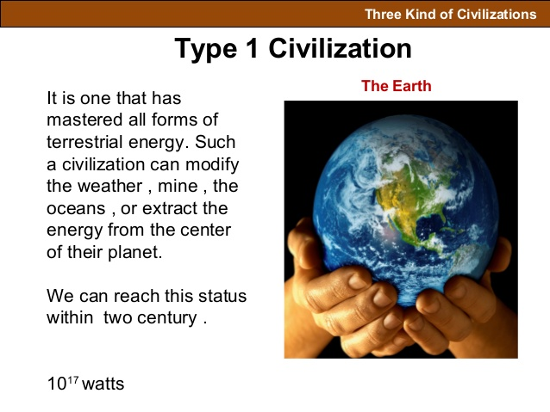
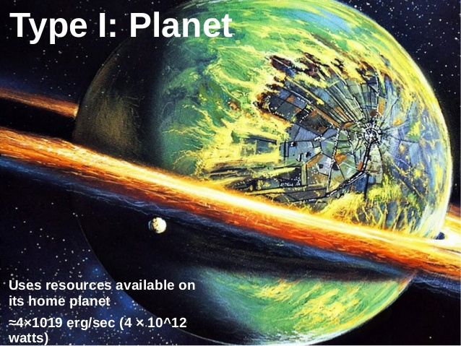
Type 1 Civilization

Slide 7
Type 1 Civilization
Technological level of a civilization that is "close to the level presently attained on Earth, with energy consumption at ≈4×1019 erg/sec" (4×1012 watts). Currently, the civilization of Type I is usually defined as one that can harness all the energy that falls on a planet from its parent star (for Earth–Sun system, this value is close to 1.74×1017 watts), which is about four orders of magnitude higher than the amount presently attained on Earth, with energy consumption at ≈2×1013 watts. The astronomer Guillermo A. Lemarchand stated this as a level near contemporary terrestrial civilization with an energy capability equivalent to the solar insolation on Earth, between 1016 and 1017 watts.

Slide 8
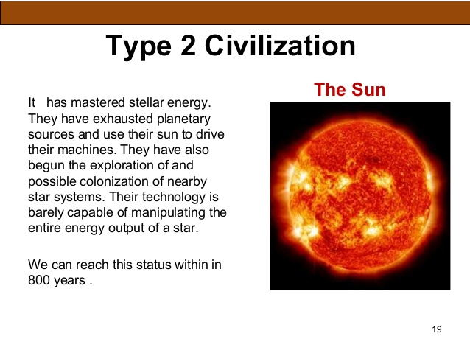
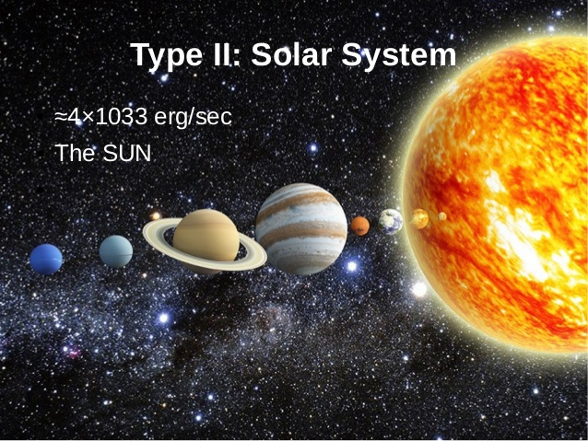
Type 2 Civilization

Slide 9
Type 2 Civilization
A civilization capable of harnessing the energy radiated by its own star—for example, the stage of successful construction of a Dyson sphere—with energy consumption at ≈4×1033 erg/sec. Lemarchand stated this as a civilization capable of using and channeling the entire radiation output of its star. The energy use would then be comparable to the luminosity of the Sun, about 4×1033 erg/sec (4×1026 watts).

Slide 10
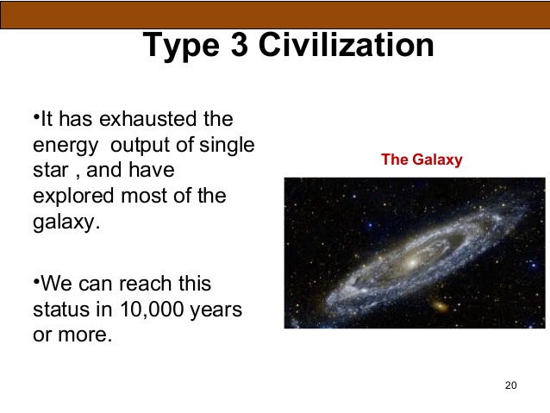
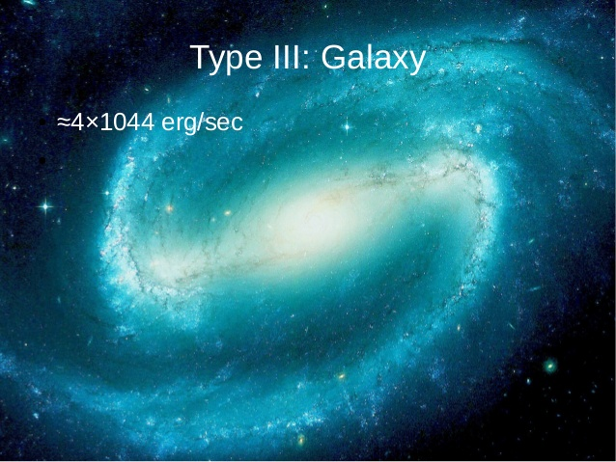
Type 3 Civilization

Slide 11
Type 3 Civilization
A civilization in possession of energy at the scale of its own galaxy, with energy consumption at ≈4×1044 erg/sec. Lemarchand stated this as a civilization with access to the power comparable to the luminosity of the entire Milky Way galaxy, about 4×1044 erg/sec (4×1037 watts).

Slide 12
Energy development

Slide 13
Type I civilization methods
Antimatter in large quantities would have a mechanism to produce power on a scale several magnitudes above the current level of technology.[citation needed] In antimatter-matter collisions, the entire rest mass of the particles is converted to radiant energy. Their energy density (energy released per mass) is about four orders of magnitude greater than that from using nuclear fission, and about two orders of magnitude greater than the best possible yield from fusion. The reaction of 1 kg of anti-matter with 1 kg of matter would produce 1.8×1017 J (180 petajoules) of energy.
Although antimatter is sometimes proposed as a source of energy, this does not appear feasible. Artificially producing antimatter according to current understanding of the laws of physics—involves first converting energy into mass, which yields no net energy. Artificially created antimatter is only usable as a medium of energy storage, not as an energy source, unless future technological developments (contrary to the conservation of the baryon number, such as a CP violation in favour of antimatter) allow the conversion of ordinary matter into anti-matter. Theoretically, humans may in the future have the capability to cultivate and harvest a number of naturally occurring sources of antimatter.

Slide 14
Renewable energy through converting sunlight into electricity—either by using solar cells and concentrating solar power or indirectly through biofuel, wind and hydroelectric power. There is no known way for human civilization to use the equivalent of the Earth's total absorbed solar energy without completely coating the surface with human-made structures, which is not feasible with current technology. However, if a civilization constructed very large space-based solar power satellites, Type I power levels might become achievable—these could convert sunlight to microwave power and beam that to collectors on Earth.
Large-scale application of fusion power. According to mass–energy equivalence, Type I implies the conversion of about 2 kg of matter to energy per second. An equivalent energy release could theoretically be achieved by fusing approximately 280 kg of hydrogen into helium per second, a rate roughly equivalent to 8.9×109 kg/year. A cubic km of water contains about 1011 kg of hydrogen, and the Earth's oceans contain about 1.3×109 cubic km of water, meaning that humans on Earth could sustain this rate of consumption over geological time-scales, in terms of available hydrogen.

Slide 15
Type II civilization methods
Type II civilizations might use the same techniques employed by a Type I civilization, but applied to a large number of planets in a large number of planetary systems.
A Dyson sphere or Dyson swarm and similar constructs are hypothetical megastructures originally described by Freeman Dyson as a system of orbiting solar power satellites meant to enclose a star completely and capture most or all of its energy output.
Another means to generate usable energy would be to feed a stellar mass into a black hole, and collect photons emitted by the accretion disc.[16][17] Less exotic would be simply to capture photons already escaping from the accretion disc, reducing a black hole's angular momentum; this is known as the Penrose process.

Slide 16
Star lifting is a process where an advanced civilization could remove a substantial portion of a star's matter in a controlled manner for other uses.
Antimatter is likely to be produced as an industrial by product of a number of mega scale engineering processes (such as the aforementioned star lifting) and, therefore, could be recycled.
In multiple-star systems of a sufficiently large number of stars, absorbing a small but significant fraction of the output of each individual star.

Slide 17
Type III civilization methods
Type III civilizations might use the same techniques employed by a Type II civilization, but applied to all possible stars of one or more galaxies individually.
They may also be able to tap into the energy released from the supermassive black holes which are believed to exist at the Center of most galaxies.
White holes, if they exist, theoretically could provide large amounts of energy from collecting the matter propelling outwards.
Capturing the energy of gamma-ray bursts is another theoretically possible power source for a highly advanced civilization.
The emissions from quasars are comparable to those of small active galaxies and could provide a massive power source if collectable.

Slide 18
So now you’ll must be thinking that “where is the evidence?”
Right
Now see the Evidence!

Slide 19
Observational evidence

Slide 20
Observational evidence
In 2015, a study of galactic mid-infrared emissions came to the conclusion that "Kardashev Type-III civilizations are either very rare or do not exist in the local Universe".
In 2016, Paul Gilster, author of the Centauri Dreams website, described a signal apparently from the star HD 164595 as requiring the power of a Type I or Type II civilization, if produced by extraterrestrial lifeforms. However, in August 2016 it was discovered that the signal's origin was most likely a military satellite orbiting the Earth.

Slide 21
Extensions to the original scale
So now you’ll may be thinking that
“Are there any civilizations beyond Type 3 Civilization?”
So the answer to this is absolutely yes
there are Civilizations beyond Type 3.

Slide 22
Type 4 Civilization
Type IV civilizations would almost be able to harness the energy content of the entire universe and with that, they could traverse the accelerating expansion of space (furthermore, advance races of these species may live inside supermassive black holes). To previous methods of generating energy, these kinds of feats are considered impossible.
A Type IV civilization would need to tap into energy sources unknown to us using strange, or currently unknown, laws of physics.

Slide 23
Type 5 Civilization
Type V might just be the next possible advancement to such a civilization. Here beings would be like gods, having the knowledge to manipulate the universe as they please.

Slide 24
Type I-minus is capable of manipulating objects over the scale of themselves: building structures, mining, joining and breaking solids;
Type II-minus is capable of manipulating genes and altering the development of living things, transplanting or replacing parts of themselves, reading and engineering their genetic code;
Type III-minus is capable of manipulating molecules and molecular bonds, creating new materials;
Type IV-minus is capable of manipulating individual atoms, creating nanotechnologies on the atomic scale and creating complex forms of artificial life;
Type V-minus is capable of manipulating the atomic nucleus and engineering the nucleons that compose it;
Type VI-minus is capable of manipulating the most elementary particles of matter (quarks and leptons) to create organized complexity among populations of elementary particles; culminating in:
Type Omega-minus is capable of manipulating the basic structure of space and time.

Slide 25
Criticism

Slide 26
Criticism
It has been argued that, because we cannot understand advanced civilizations, we cannot predict their behaviour. Thus, the Kardashev scale may not be relevant or useful for classifying extraterrestrial civilizations. This central argument is found in the 2002 book Evolving the Alien: The Science of Extraterrestrial Life.

Slide 27
Reference
https://en.wikipedia.org/wiki/Kardashev_scale
https://futurism.com/false-coloring

Slide 28

Thanks for watching….

